Slide 1
Introductory General Chemistry
Chemistry 3A
S. M. Halloran

Slide 2
Concepts
Waves
Observations on Atom Structure
Electromagnetic Radiation & Spectrum
Quantized Nature of Energy
Energy levels of Electrons
Quantum Mechanical Model of Atom
Electron "Identity": Quantum Numbers
Shells, Subshells
Orbitals and their "Shapes"
Populating (Filling) Electrons: Electron Configuration
Related Trends in Periodic Table
Atomic Radius, Ionization Energy, Electron Affinity

Slide 3
Waves
Waves are a sinusoidal motion or movement
There are terms used to talk about waves
Crest – the topmost point of a wave
Trough – the bottommost point of a wave

Slide 4
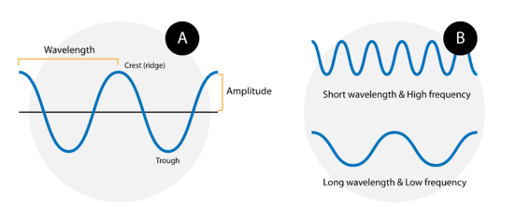
Waves
Wavelength
Distance between to corresponding points on adjacent waves
Crest-to-crest or trough-to-trough distance
Represented by Greek letter lambda (λ)
Units: some form of meter (m, nm, cm, km)
Frequency
The number of waves that pass a point in a certain period of time
Represented by Greek letter nu (ν)
Units: per unit time [waves per second (s⁻¹)]
Also called Hertz (Hz)

Slide 5

Waves
Amplitude
maximum distance or displacement of a wave from its resting (zero) position
Also called equilibrium position
represents height of wave’s crest (or trough)
indicator of the energy of a wave
higher amplitude → higher energy
Wave speed
distance a wave disturbance travels through a medium in a given amount of time
Units: distance per unit time (m/s)
indicated usually by v (velocity)
$$\text{wave} \text{speed}\text{ = }\text{wavelength}\text{ (}\text{m}\text{) }× \text{frequency}\text{ (}\text{s}\text{−1}\text{)} \\ v=λν$$

Slide 6
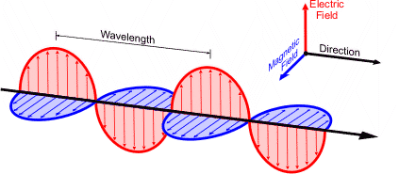
Waves
Electromagnetic radiation is a wave
Actually a wave with two components perpendicular (at right angles, 90° to) each other
Electric field wave
Magnetic field wave

Slide 7
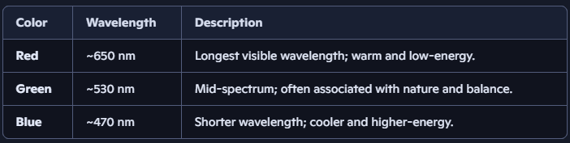
Waves
It is typical to talk about EM waves with respect to their wavelength
Frequency is required when you make energy calculations—slide after next slide!
In the visible light spectrum, wavelengths are from 400-700 nanometers (nm).

Slide 8

Making A Calculation
What is the frequency of green light at 530 nm?
$$c=λν$$
$$v=\frac{c}{λ}$$
$$v=\frac{3.00 ×{10}^{8} \text{m}}{ \text{s}}×\frac{1}{530 \text{nm} }×\frac{{10}^{9} \text{nm}}{1 \text{m}}=5.66 ×{10}^{14}{ \text{s}}^{−1}$$
or 5.66 x 10¹⁴ Hz
Algebra + conversion factors + a natural constant (the speed of light)

Slide 9
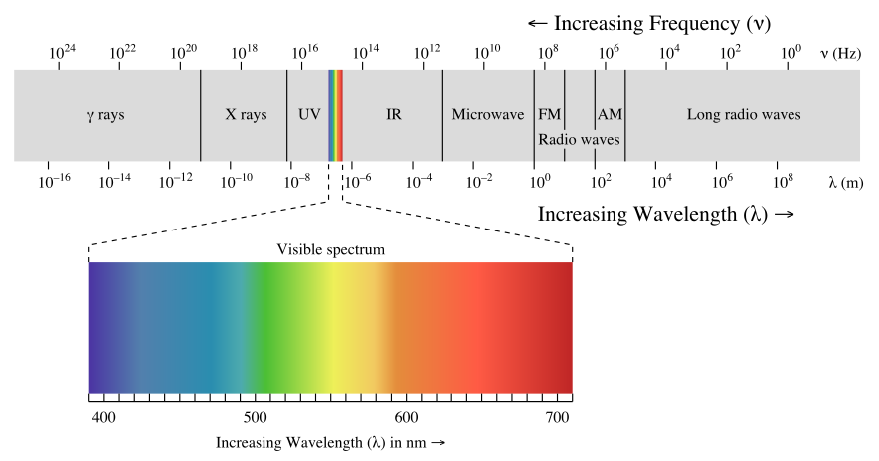

Electromagnetic Spectrum
Spans from radio waves to gamma rays
Our eyes detect a narrow part of the EM spectrum called “visible light”
EM radiation has ENERGY that is calculated using the famous Planck’s equation
$$E=hν$$
EM radiation that is “ionizing” has frequencies in the UV and higher (X-rays, γ rays)

Slide 10

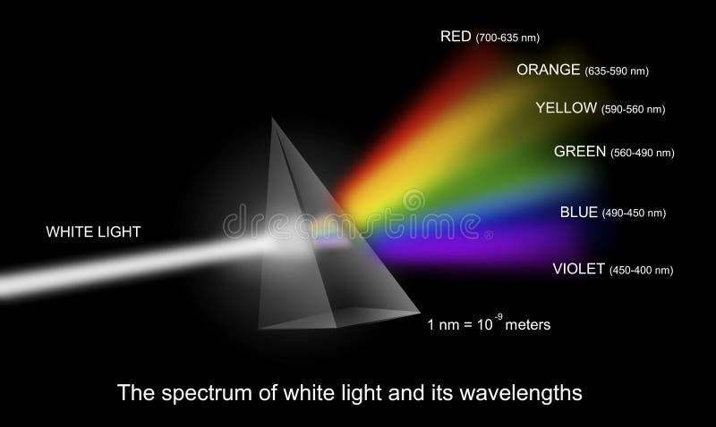
The Light Bulb
An electric current passes through the tungsten filament
Element symbol W
The filament resists the flow, heating to ~3000 °C
At this high temperature, it emits blackbody radiation
The spectrum spans visible wavelengths, so the glow appears white light
⚡ This is not from tungsten’s atomic emission spectrum

Slide 11
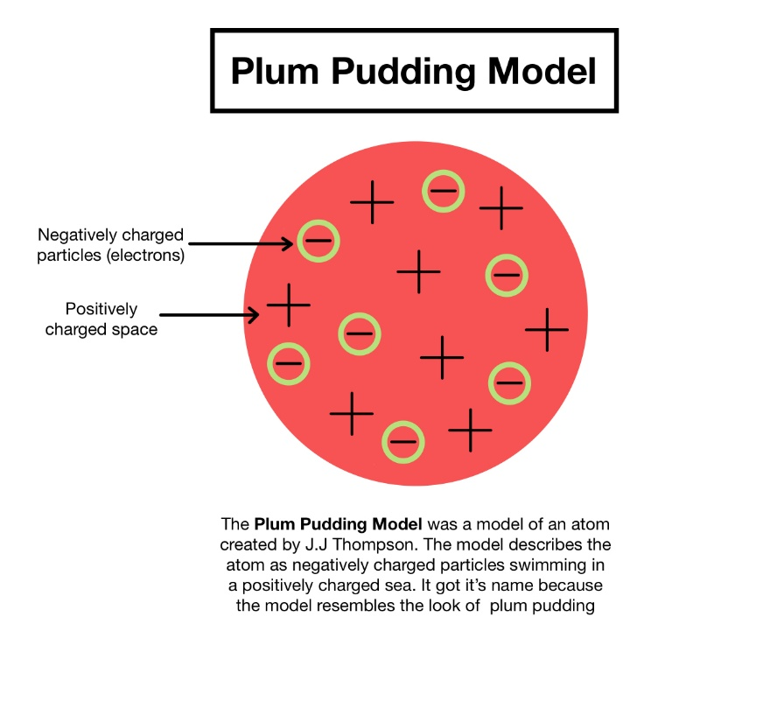
Historical Observations
1897 JJ Thomson discovers the electron is a negatively charged particle
Proposes “plum pudding” model of atom
Electrons and protons in a mix (cloud)
No nucleus

Slide 12
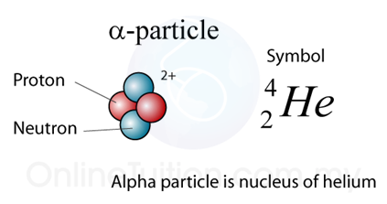
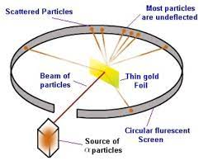
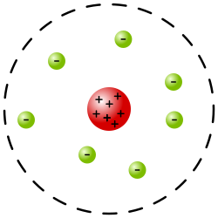
Historical Observations
1909 Rutherford aimed alpha particles at thin gold foil and he sees that they pass through the foil and some are deflected
Alpha particles are positively charged helium atoms (⁴He)
Important findings
Gold foil atoms must have space in them or the alpha particles would not pass through
The deflections would have to be positive charges in the gold foil, since positive charges repel
Rutherford proposes a positively charged “nucleus” with electrons outside of it (did not describe orbits)

Slide 13
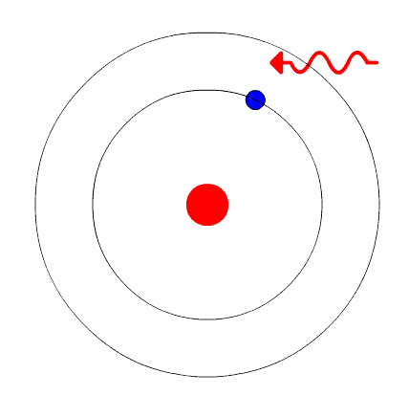
Atoms & Orbiting Electrons
The Bohr Model
Electrons orbit the nucleus in fixed energy levels
Electrons can transition between energy levels by absorbing or emitting a photon as a quantum of energy
Transition between a ground state and excited state
Explained the hydrogen emission spectrum with mathematical precision

Slide 14
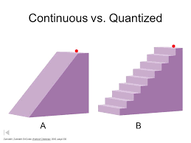
Quantized vs Continuous
Energy level transitions in atoms are quantized
Electrons cannot absorb just any amount of energy
They can only move between specific energy levels with exact energy differences
If incoming photon does not have required amount of energy, no transition occurs

Slide 15
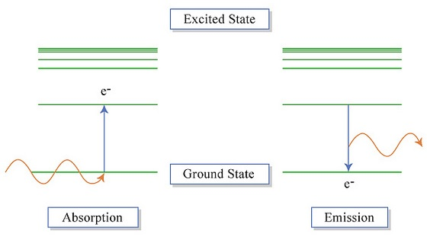
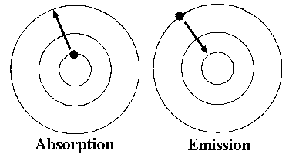
Electrons & Energy Levels
An electron in an atom moves in an orbit about the nucleus of the atom
Its usual orbit is in a ground state, its lowest energy state
When given energy through the “absorption” of a photon (EM radiation), it jumps to another a higher energy level, an orbit further away from the nucleus. It is in an excited state.
When it loses its energy back to its ground state, it emits a photon.

Slide 16
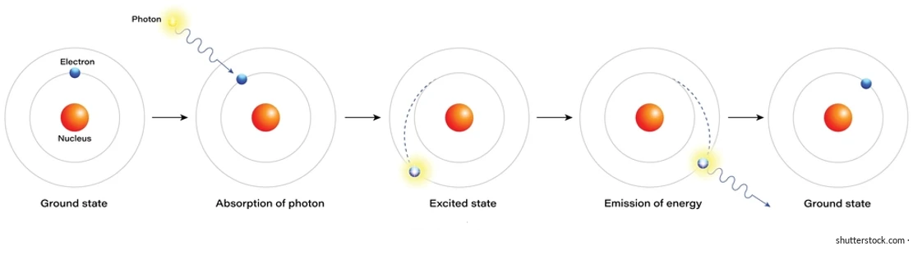
Electrons and EM Radiation
This cycle of absorbing photon in the ground state and being excited (the excited state) to an energy level and then relaxing or losing that energy back to the ground state with emission of a photon shown below

Slide 17
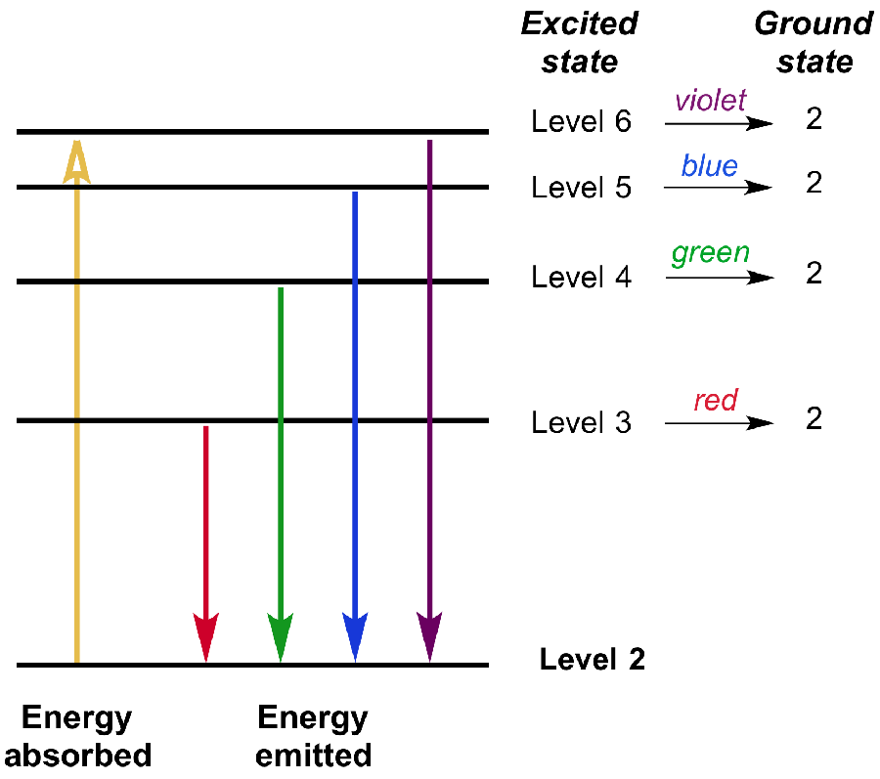
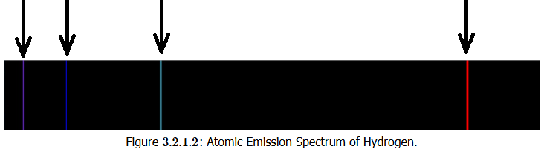

Emission Spectrum
These electron energy level transitions explain the emission spectra observations
Hydrogen atom has only a few energy transitions
Iron atom has numerous of these transitions

Slide 18
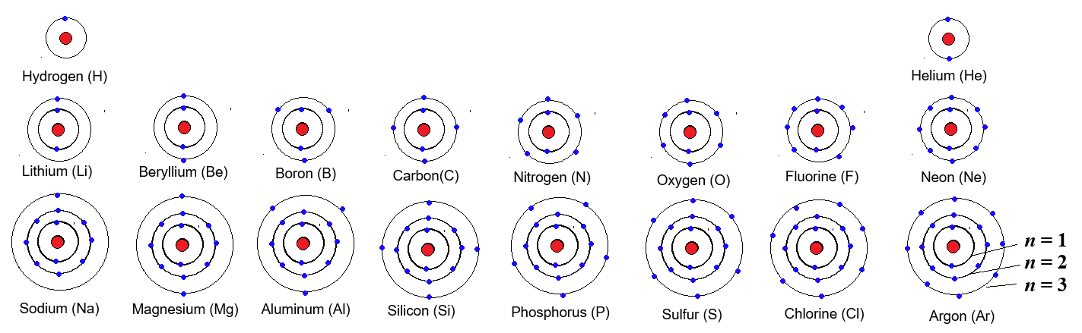
Quantum Mechanics Model
Following Bohr’s explanations, a model for how electrons exist
Electrons have an identity: quantum numbers
There are 4 quantum numbers for each electron

Slide 19
Quantum Numbers: Meaning
Principal Quantum Number (n)
describes main energy level or shell the electron is in
the bigger the number (1,2,3,...), the farther the electron is from the nucleus and the higher its energy
Angular Momentum Quantum Number (l)
describes shape of the orbital, or the region where the electron is likely to be found
the shapes are given letter names (come from spectroscopy): s (sphere), p (dumbbell), d (cloverleaf), f (double cloverleaf)
Magnetic Quantum Number (m_{l})
Describes the orientation of the orbital in 3D space
For a dumbbell-shaped p-orbital, this number tells you if it's on the x, y, or z-axis
Spin Quantum Number (m_{s})
Describes an electron's intrinsic "spin"
There are only two possible values: spin up (+1/2) or spin down (−1/2)
Every orbital can hold a maximum of two electrons
They must have opposite spins

Slide 20
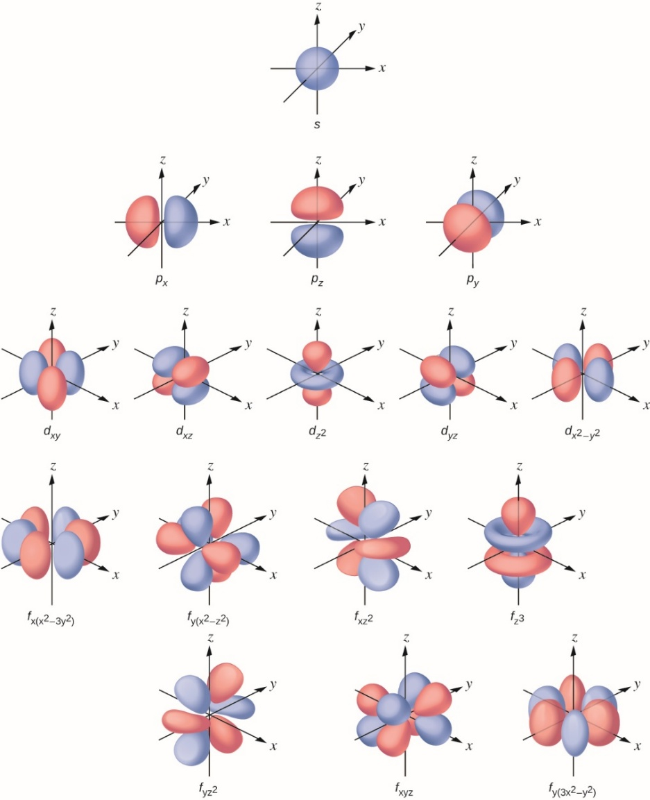
Orbitals and Electron Configurations
Orbital shapes are actually mathematical calculations describing the space where an electron can be found
Probabilities functions
Depending on the value of n (the shell), there is possible
only one s orbital
three p orbitals
five d orbitals
seven f orbitals
Each orbital can have only two electrons

Slide 21
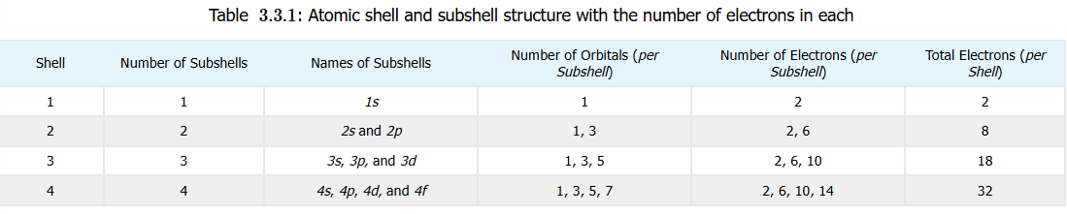
Orbitals and Electron Configurations
Why these patterns in this detail?
Because it explains the nature of the atoms and Periodic Table
It explains the periods (rows) and the groups (columns)
This will be an exercise in memorization of these patterns of matter, nature, and the atom

Slide 22
Atomic Structure Glossary
Term | Definition | Symbol/Example
Shell | A major energy level in an atom, defined by principal quantum number n. All electrons with same n are in same shell | n = 1, 2, 3, …
Subshell | Subdivision of shell defined by the azimuthal quantum number l. Determine the shape of the orbital | l = 0 (s), l = 1 (p), l = 2 (d), l = 3 (f)
Energy Level | Used synonymously with shell (but can refer to quantized energy associated with electron’s position in atom | Can also refer to ground state vs excited state
Energy Sublevel | Informal term for subshell and it emphasizes the energy hierarchy within a shell | 3s < 3p < 3d (within shell n = 3)
Orbital | A region of space where there is high probability of finding an electron. Defined by (n, l, m_{l}) | Examples: 2p_{x}, 3d_{xy}

Slide 23
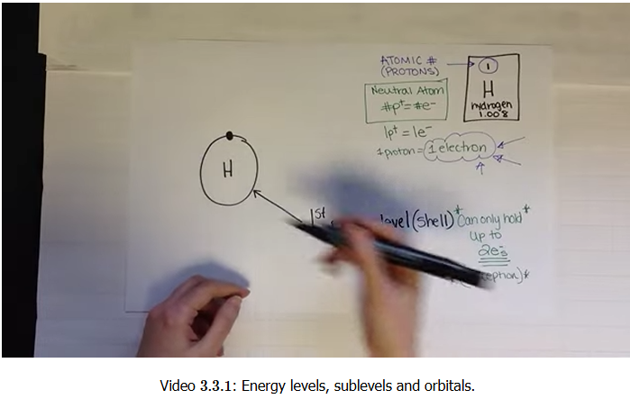
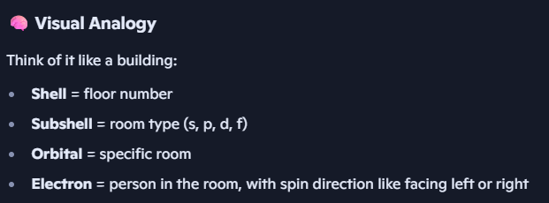
Quantum Number Relationships
More info for emphasis
Shell → defined by n
Subshell → defined by n and l
Orbital → defined by n, l , m_{l}
Electron spin → defined by m_{s}, either +½ or −½
This use of many terms is indicated to you because a 9-minute video in your book also uses certain terms

Slide 24
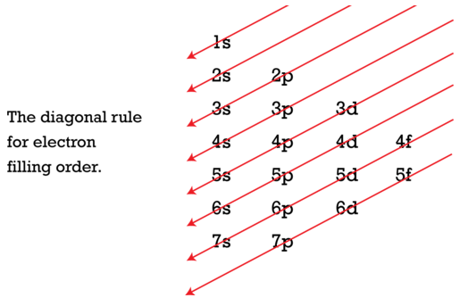
Orbital Filling
Aufbau Principle
In “filling” the atom’s orbitals so that electron’s are added in order of lowest to higher energy, use the n + l Aufbau Principle. The lower value gets filled first (“Aufbau” is “build up” in German)
WAIT!!
Shouldn’t n = 4 have higher energy level than n = 3, so why fill 4s before 3d !!??
Well…it’s really n + l 4s = 4 + 0 = 4
3d = 3 + 2 = 5
So 4s gets filled first
shape | l
s | 0
p | 1
d | 2
f | 3

Slide 25
Quantum Number Uniqueness
Pauli Exclusion Principle
Remember those four quantum numbers that indicate the “identity” of an electron in the atom?
The Pauli Exclusion Principle is just a rule that states that no two electrons in an atom can have the same four quantum numbers, the same “identity”

Slide 26
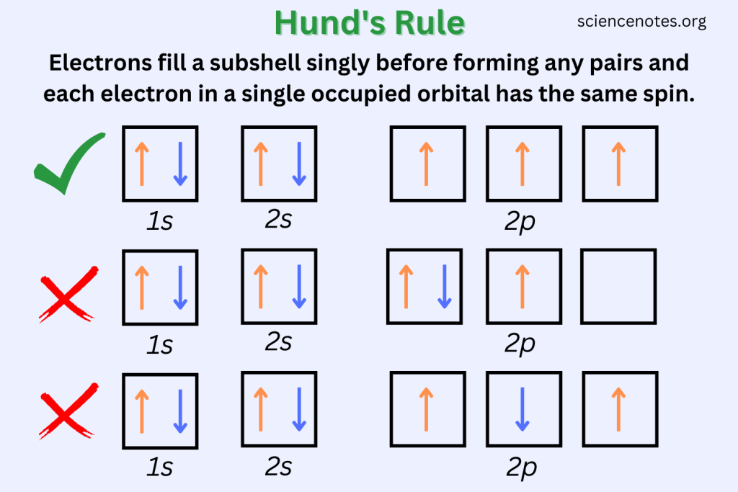
Unpaired vs Paired Electrons
Hund’s Rule
Electrons can be “paired” into orbitals (2 e⁻ per orbital)
They must have opposite spins
But pairing requires an energy input
For orbitals of the same energy level (degenerate orbitals), fill the orbitals FIRST with one electron, and as filling proceeds, then pair them
This applies to p (3 degenerate orbitals), d (5), and f (7). The s orbital has only one energy level

Slide 27
Electron Configurations
The electrons that will complete a particular atom are presented in a particular format called an electron configuration
The format is
<n-number><l-letter>^{<# of electrons superscript>}
The n-number will be shell number: 1, 2, 3, 4, 5, 6, 7
The l-letter will be subshell designation: s, p, d, f
The # of electrons in superscript are the range of electrons possible for the subshell: s → 1 × 2 = 2 , p → 3 × 2 = 6, d → 5 × 2 = 10,
f → 7 × 2 = 14

Slide 28
Electron Configurations
Actual electron configuration in 2nd column
The 3rd column shows the filling of orbitals according to Hund’s Rule
Hydrogen | 1s¹
Helium | 1s²
Lithium | 1s²2s¹
Beryllium | 1s²2s²
Boron | 1s²2s²2p¹ | 1s²2s²2p_{x}¹
Carbon | 1s²2s²2p² | 1s²2s²2p_{x}¹p_{y}¹
Nitrogen | 1s²2s²2p³ | 1s²2s²2p_{x}¹p_{y}¹p_{z}¹
Oxygen | 1s²2s²2p⁴ | 1s²2s²2p_{x}²p_{y}¹p_{z}¹
Fluorine | 1s²2s²2p⁵ | 1s²2s²2p_{x}²p_{y}²p_{z}¹
Neon | 1s²2s²2p⁶ | 1s²2s²2p_{x}²p_{y}²p_{z}²

Slide 29
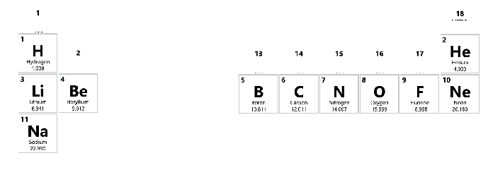
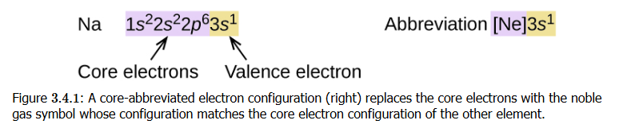
Core and Valence Electrons
The outermost shell (shells designated by the n value) of the atom contains electrons called the valence electrons
All other (inner) shells form the core electrons

Slide 30
Electron Configurations
Hydrogen (H) | 1s¹ | Iron (Fe) | [Ar]3d⁶4s²
Helium (He] | 1s² | Copper (Cu) | [Ar] 3d¹⁰4s¹
Lithium (Li) | [He]2s¹ | Zinc (Zn) | [Ar]4s²3d¹⁰
Boron (B) | [He]2s²2p¹ | Silver (Ag) | [Kr]5s¹4d¹⁰
Carbon (C) | [He]2s²2p³ | Platinum (Pt) | [Xe]4f¹⁴5d⁹6s¹
Sodium (Na) | [Ne]3s¹ | Gold (Au) | [Xe] 4f¹⁴5d¹⁰6s¹
Magnesium (Mg) | [Ne]3s² | Mercury (Hg) | [Xe] 4f¹⁴5d⁹6s¹
Copper: (move 4s electron to 3d!) making 3d¹⁰4s¹ is more energetically stable than expect 3d⁹4s²
Zinc: not a transition metal (!) according to IUPAC
Silver: like copper in filling the d-subshell
Platinum: big exception in stabilizing 5d subshell
Gold: Move from 6s to 5d completes the 5d subshell!

Slide 31
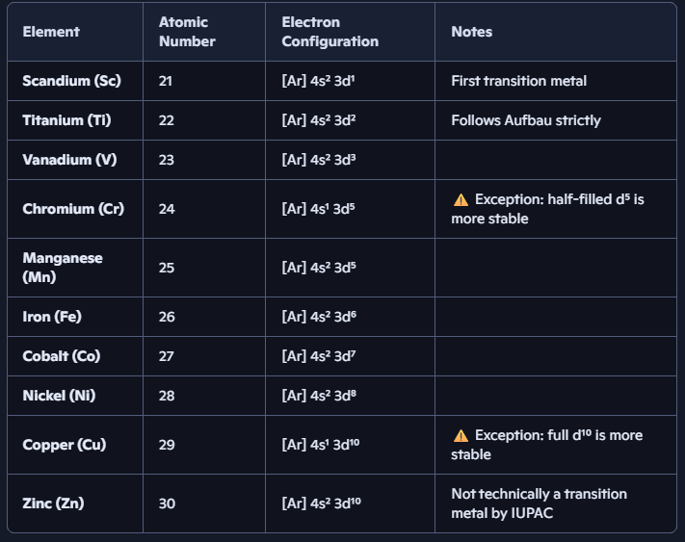
Exceptions to Rules Always
Notice an electron is taken from 4s and put into 3d for some of the elements!
It’s always about a more energetically stable configuration

Slide 32
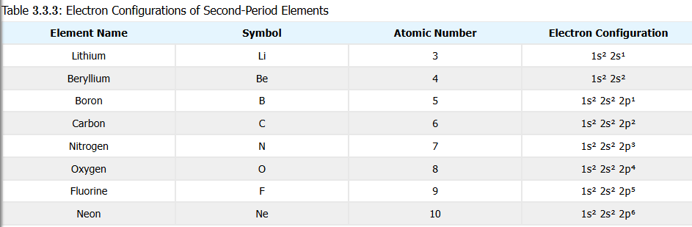
Second Period Elements
1st period has only two elements: hydrogen (H) and helium (He)
2nd period has 8 elements
Along with hydrogen (H), 2nd period elements are the most important to life: carbon (C), nitrogen (N), oxygen (O)

Slide 33
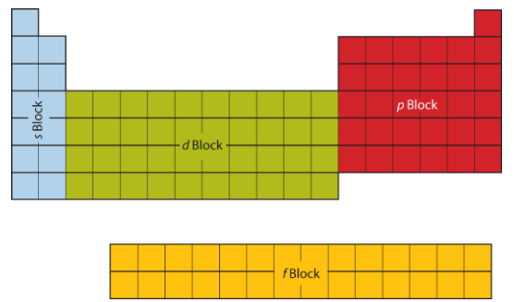
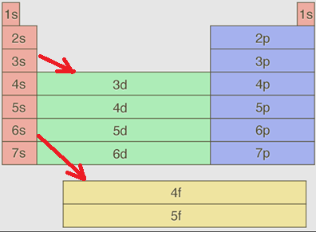
Electron Configurations and Periodic Table
Subshells important
s → 1 = 1 x 2e⁻ = 2e⁻
p → 3 = 3 x 2e⁻ = 6e⁻
d → 5 = 5 x 2e⁻ = 10e⁻
f → 7 = 7 x 2e⁻ = 14e⁻
Note how 3d is in the 4th period and 4f actually starts in the 6th period!
Why??

Slide 34
The n + l Rule (Aufbau Principle Reiterated)
Why does 3d occur in the 4th period and 4f occur in the 6th period?
Orbitals with lowest n + l get filled first
If two orbitals have same n + l the one with smaller n fills first
4s (n =4, l =0) → n + l = 4
3d (n =3, l =2) → n + l = 5
4f (n =4, l =3) → n + l = 7
6s (n =6, l =0) → n + l = 6
Explains why 4s fills before 3d,
And 6s before 4f
n
1
2
3
4
5
6
7
l
s | 0
p | 1
d | 2
f | 3

Slide 35
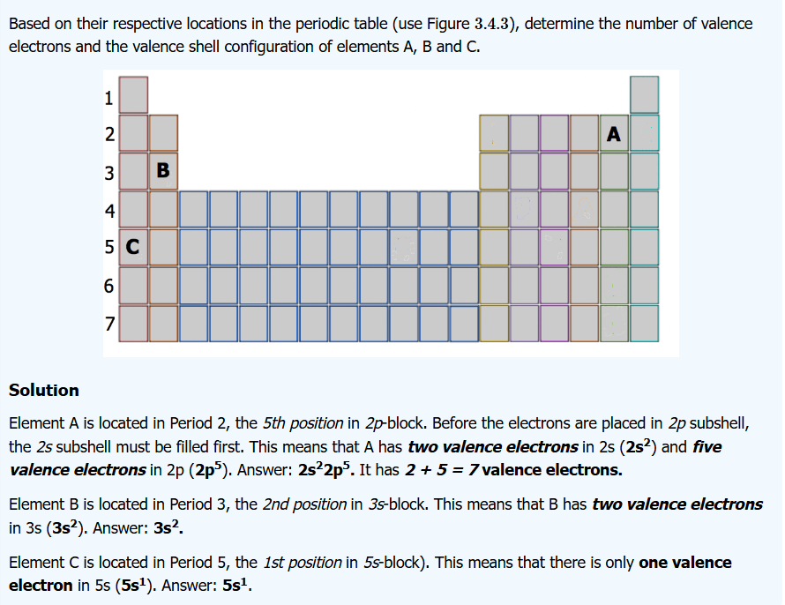
Figuring Out Valence Electron Numbers

Slide 36
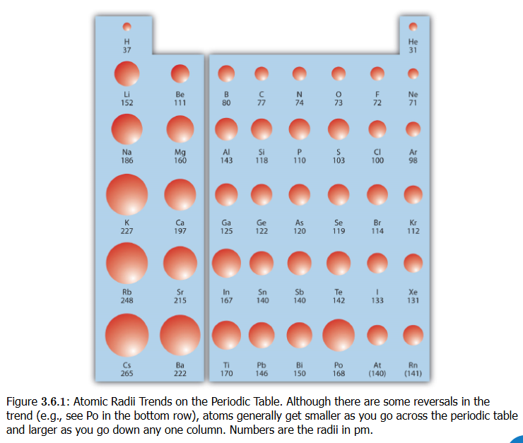
Atomic Radius (“size”)
Going DOWN the table (1st, 2nd, … period), the radius INCREASES
Adding shells makes an atom bigger generally
Going RIGHT in table (1st,2nd … groups), the radius DECREASES
Adding protons without adding a shell pulls all electrons in closer to nucleus

Slide 37

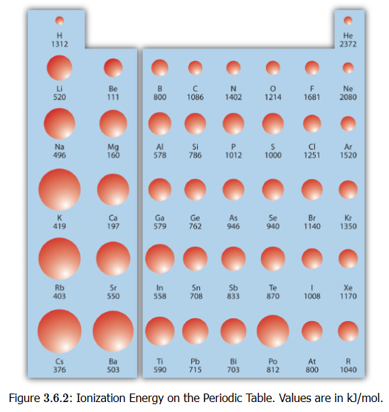
Ionization Energy
Going DOWN the table (1st, 2nd, … period), the ionization energy DECREASES
Easier to remove one valence electron as valence shell gets further away from nucleus
Going RIGHT in table (1st,2nd … groups), the ionization energy INCREASES
Because radius decreases, valence electrons are brought in closer, so takes more energy to ionize

Slide 38
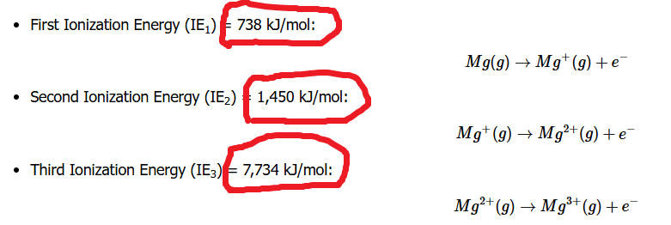
2nd, 3rd,… Ionization Energies
Removing additional electrons requires more energy because each ion becomes increasingly positive, strengthening its hold on remaining electrons. Electrostatic attraction grows, making further ionization energetically costly

Slide 39

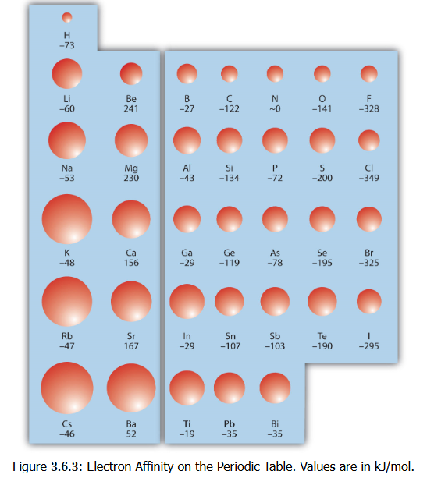
Electron Affinity (EA)
Going DOWN the table (1st, 2nd, … period), there appears to be no clear trend
As atom gets larger, they have more diffuse electron clouds: any added electron experiences weaker attraction to nucleus, so energy release less significant
Going RIGHT in table (1st,2nd … groups), the electron affinity INCREASES
Atoms strongly favor gaining electrons to complete the valence shell, and the added electron releases energy in stabilizing the atom

Slide 40
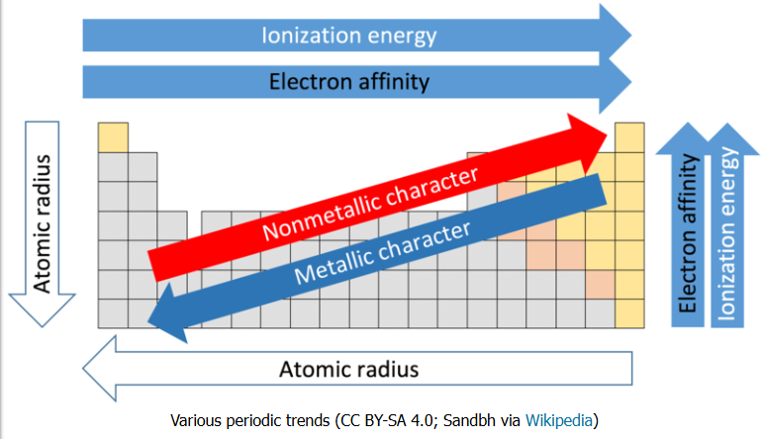
Summary of Periodic Trends

